Slide 1
Chapter 12
Accessing DOM Elements in React

Slide 2
Objectives
The Colorizer Example
Meet Refs
Using Portals

Slide 3
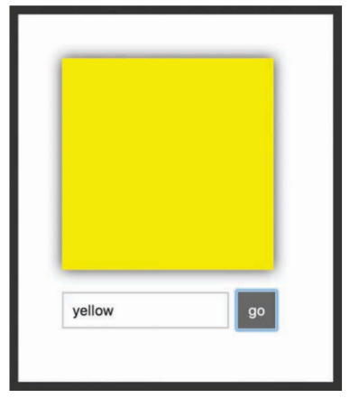
The Colorizer Example
The Colorizer colorizes the white square with whatever color you provide it. To see it in action, enter a color value inside the text field and click/tap the Go button. After you provide a color and submit it, the white square turns whatever color value you provided

Slide 4
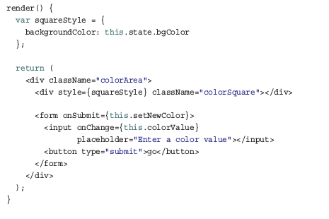
Meet Refs
The way refs works is a little odd. The easiest way to make sense of it is to just use it. Take a look at just the render method from our Colorizer example:

Slide 5
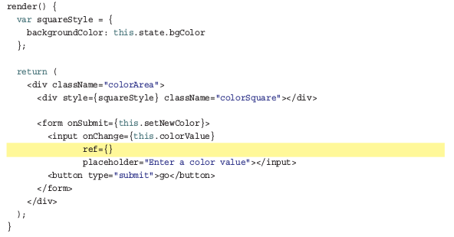
Meet Refs
The way we do that using refs is by setting the ref attribute on the element whose HTML we want to reference:

Slide 6
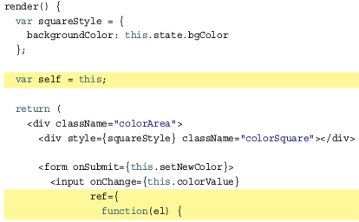
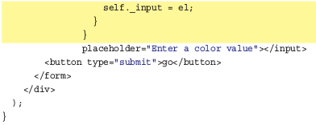
Meet Refs
Because we’re interested in the input element, our ref attribute is attached to it. Right now, our ref attribute is empty. What you typically set as the ref attribute’s value is a JavaScript callback function. This function gets called automatically when the component housing this render method gets mounted.

Slide 7
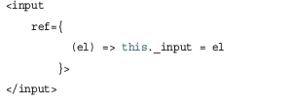
Meet Refs
Simplifying Further with ES6 Arrow Functions
Learning React is hard enough, so I’ve tried to avoid forcing you to use ES6 techniques by default. When it comes to working with the ref attribute, using arrow functions to deal with the callback function simplifies matters a bit.
To deal with context shenanigans, we created a self variable initialized to this , to ensure that we created the _input property on our component. That seems unnecessarily messy.

Slide 8
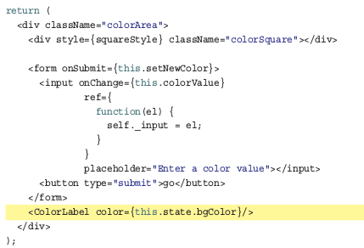
Using Portals
The point to emphasize is that our h1 element is a sibling of the container div element where our app is set to render into. To accomplish what we’re trying to do, go back to our Colorizer component’s render method and add the following highlighted line to the return statement

Slide 9
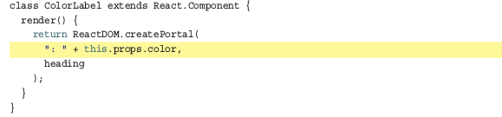
Using Portals
More specifically, notice what our return statement looks like. We are returning the result of calling ReactDOM.createPortal()
The ReactDOM.createPortal() method takes two arguments: the JSX to print and the DOM element to print that JSX to

Slide 10
Conclusion
Even though everything we’re creating is rendering to a HTML document, our React app is like a self-sufficient tropical island within the document; you never quite see the actual HTML that lies just beneath the sands.
To help you both see the HTML inside the island and make contact with things that live outside the island, we looked at two features, refs and portals.
Refs allow you to cut through and access the underlying HTML element behind the JSX.
Portals allow you to render your content to any element in the DOM that you have access to.

